Slide 1
Current arrangements at school…

Slide 2
How is school working at the moment?
Children are in a group with less than 15 others, a teacher and a teaching assistant.
Each group has their own toilets (boys and girls will need to share), own classroom, own outdoor space and a time when they can use the field.
Children must wear school uniform

Slide 3
Who shouldn’t return to school?
If your child is shielding, or if someone in your household is shielding your child shouldn’t return to school.
If your child is vulnerable (e.g. they are asthmatic or they have diabetes) or lives with someone who is vulnerable, the guidance says you should stay at home wherever possible.
In this circumstance, parents will need to make their own decision about whether you think it is safe for your child to return.

Slide 4
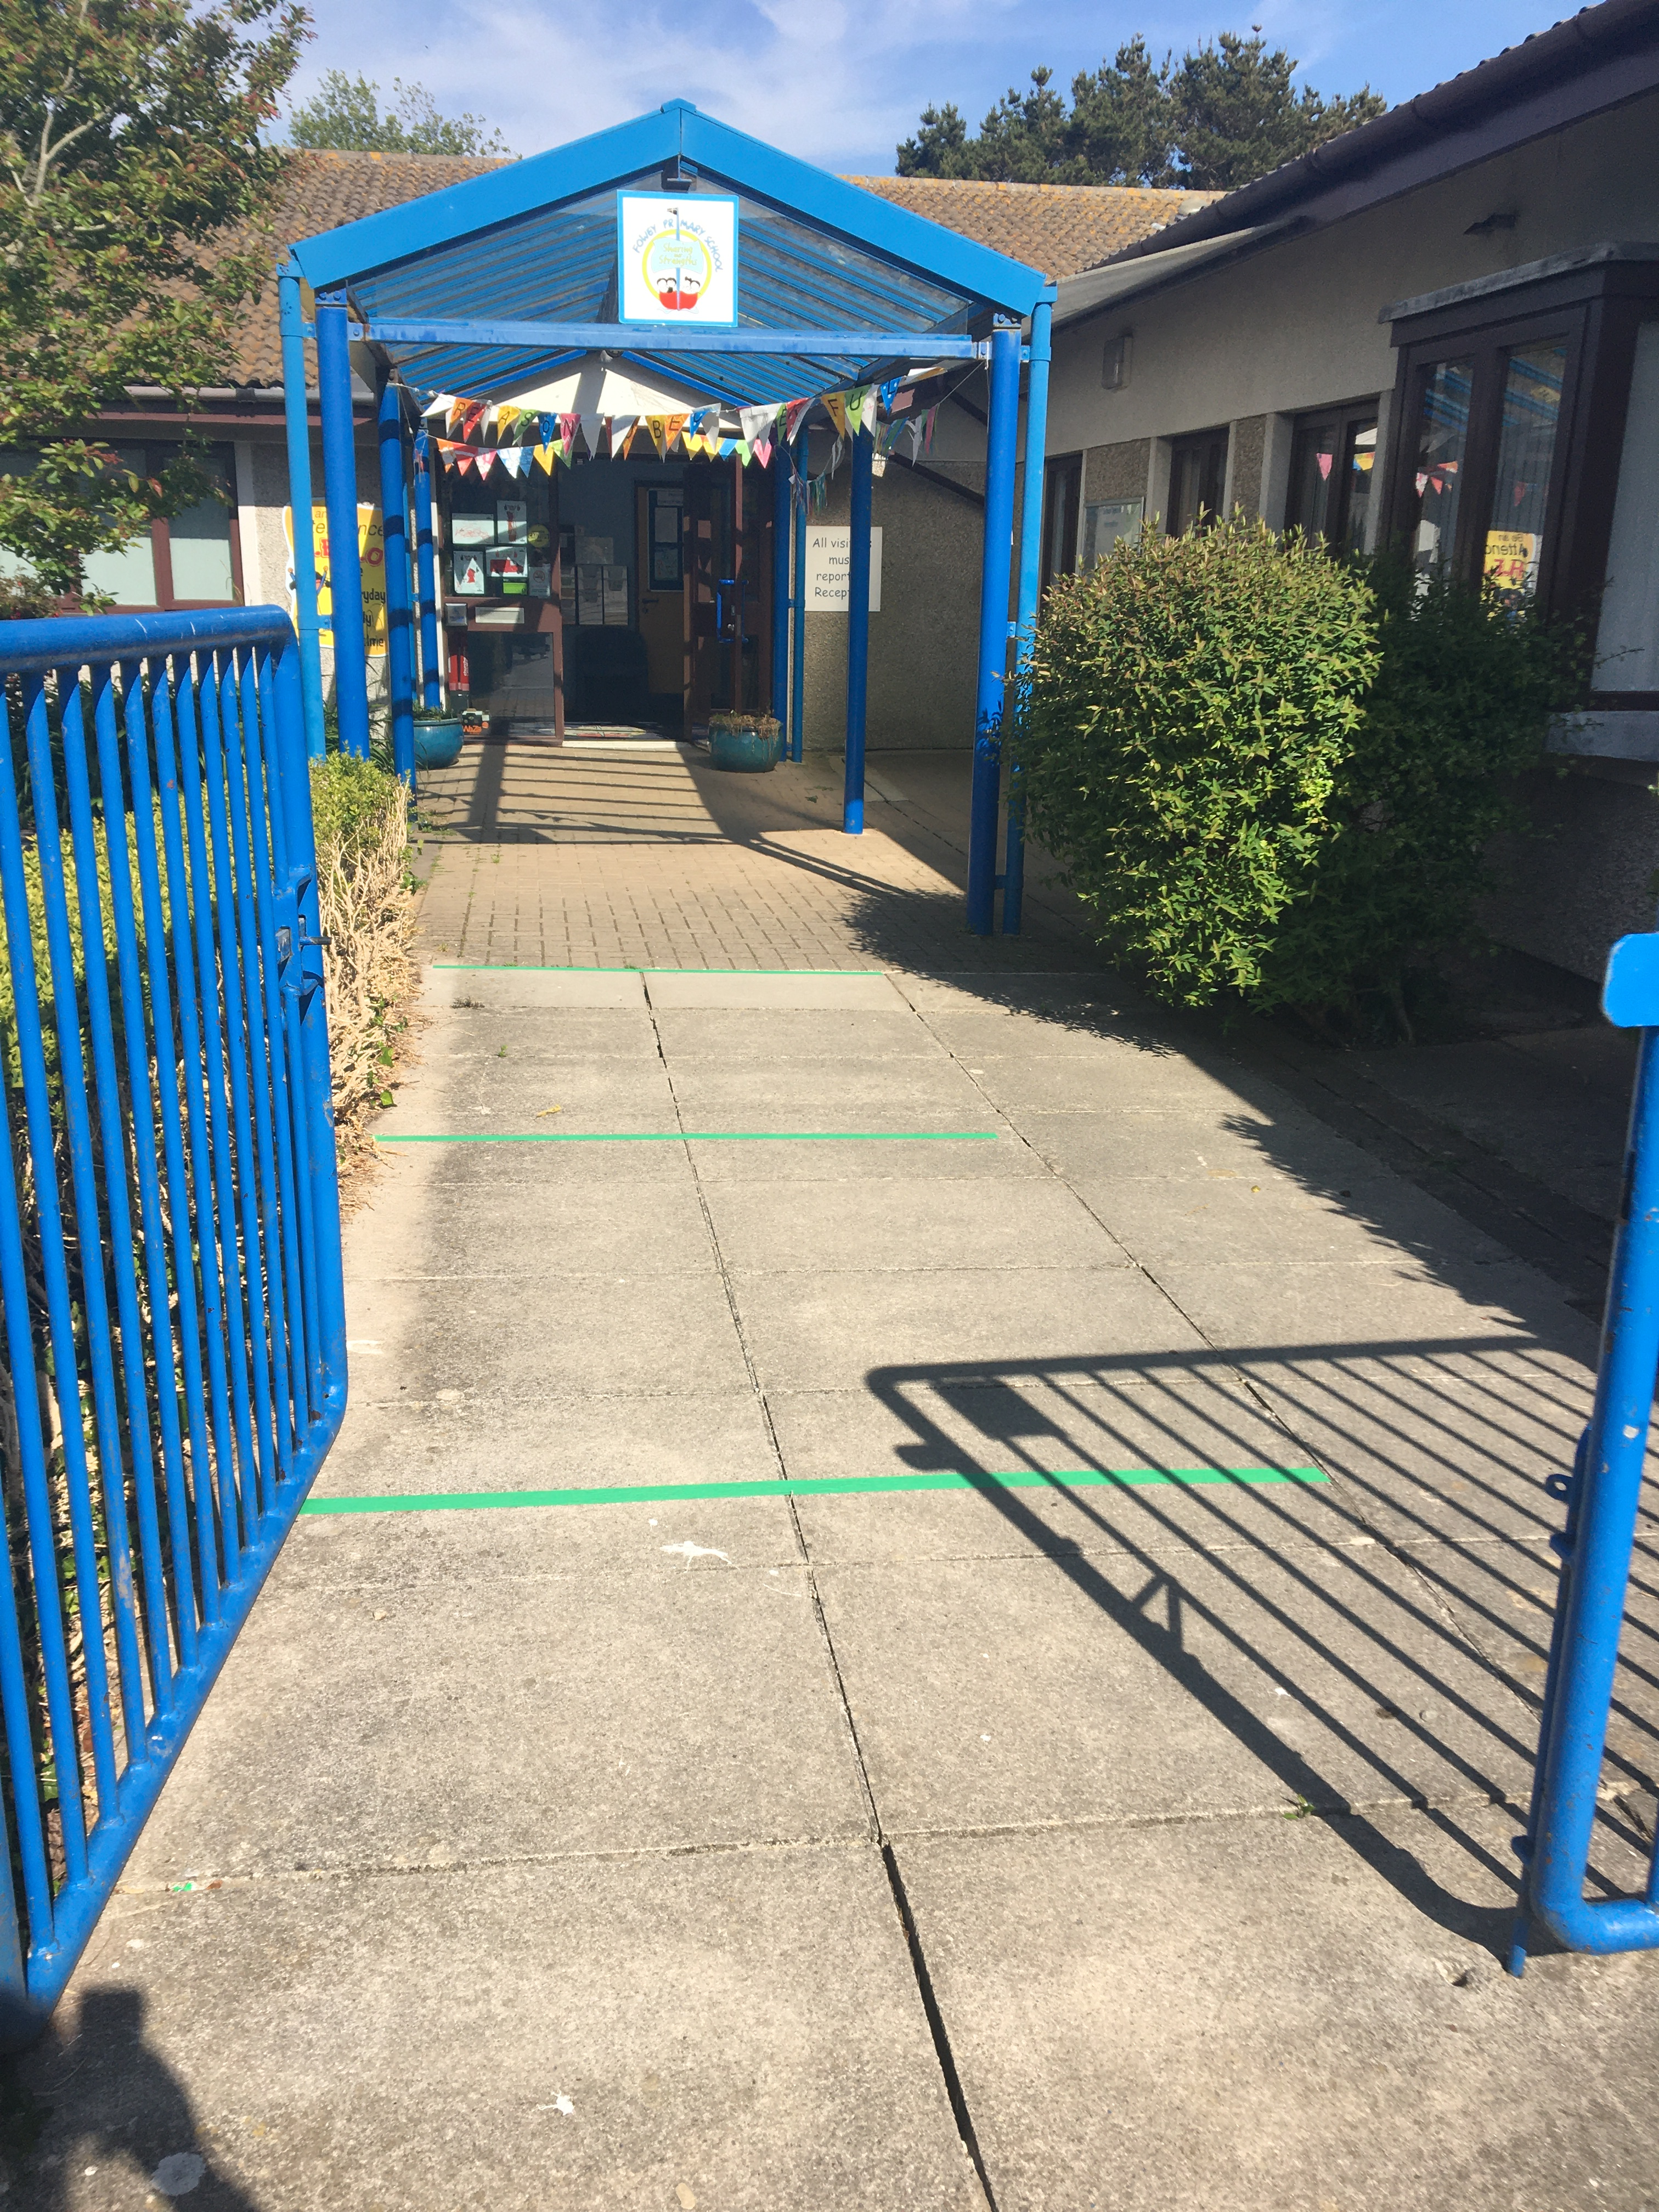
Pick up and Drop Off
Markers at the front of school
Line up with your child on a marker (in their line order)
One adult only per child- please do not bring siblings unless you have to
Please be on time but not too early! If you are early, please wait in your car or at a distance from the school.
Two entrances- green from car park, red from pedestrian entrance

Slide 5
School Day Timings
Apples
Monday-Thursday
Arrive at 8:15
Leave at 2pm
Friday collection at 12:45
Bananas
Monday- Thursday
Arrive at 8:45
Collection at 2:30
Friday collection at 12:15
All children will be at home on Friday afternoons so teachers can plan.

Slide 6
Food and Drinks
All classrooms will have a supply of disposable cups. Children should get a drink from the tap and then throw their cup away.
Fruit snacks will be provided- you shouldn’t send any in.
It is safer if all children have school dinner. If you have to send packed lunch, please make sure your child can open everything themselves as staff won’t be able to help.
School lunches will be provided free as usual for all infants and all FSM eligible children.
There will be no hot food at school, all lunches will be a packaged packed lunch. This is because children will need to eat outside or in the classrooms. They won’t be able to eat in the hall.

Slide 7
In order to reduce the risk of infection we will:
Provide all children with an individual pouch of new stationary which they should use. Children should not share any equipment.
Clean all EYFS play equipment daily and provide enough for one each (e.g. bags of playdough).
Keep groups completely separate, children will not be able to mix with other groups at any time. They will always be with one of the adults allocated to their group.
Clean classrooms regularly throughout the day. We will involve children as monitors in this where we can.
Provide first aid within each group.
Use instant ice packs rather than our usual frozen ones.
Have lidded bins and tissue stations in all classrooms.

Slide 8
In order to reduce the risk of infection we will:
Use doorstops and keep windows open to promote a good air flow
Be outside whenever we can in all classes
Not gather for assemblies or whole school events
Wash our hands and use hand sanitiser very regularly throughout the day
Stagger pick up and drop off times, maintaining social distancing during these times.
Have a line order and a table space.

Slide 9
You can help us reduce infection by:
Ensuring children do not mix with children in other groups at home.
Try not to use additional childcare so that children are mixing.
Maintaining social distancing on pick up and drop off- leaving promptly.
Staying out of the building at all times.
Encouraging your child to wash their hands and use the hand sanitiser.
Not having lengthy conversations with staff on pick up or drop off. Please e-mail if you need to speak to staff.
Keeping your child at home if they or anyone else at home has symptoms. You should apply for a test as quickly as you can.

Slide 10
Questions?

Slide 11
What happens next…
Join us for Wednesday assemblies on Zoom and for story/singing sessions with Mrs Jones
Complete the induction form on the website
Check the activities Mrs Jones has posted online
Join the school Facebook page
Mrs Jones will send you a home visit appointment
We’ll get back to you with arrangements for September as soon as we know

