Slide 1
Current arrangements at Fowey primary

Slide 2
How is school working at the moment?
Children are in a class of up to 30 children with a teacher and a teaching assistant. Several classes work together in a bubble.
Each group has their own toilets (boys and girls will need to share) and classroom. Children share the outdoor space but use it at different times, they don’t share equipment outside- we have a rota.
All children including those who are medically vulnerable can now attend school.
Children must wear school uniform

Slide 3
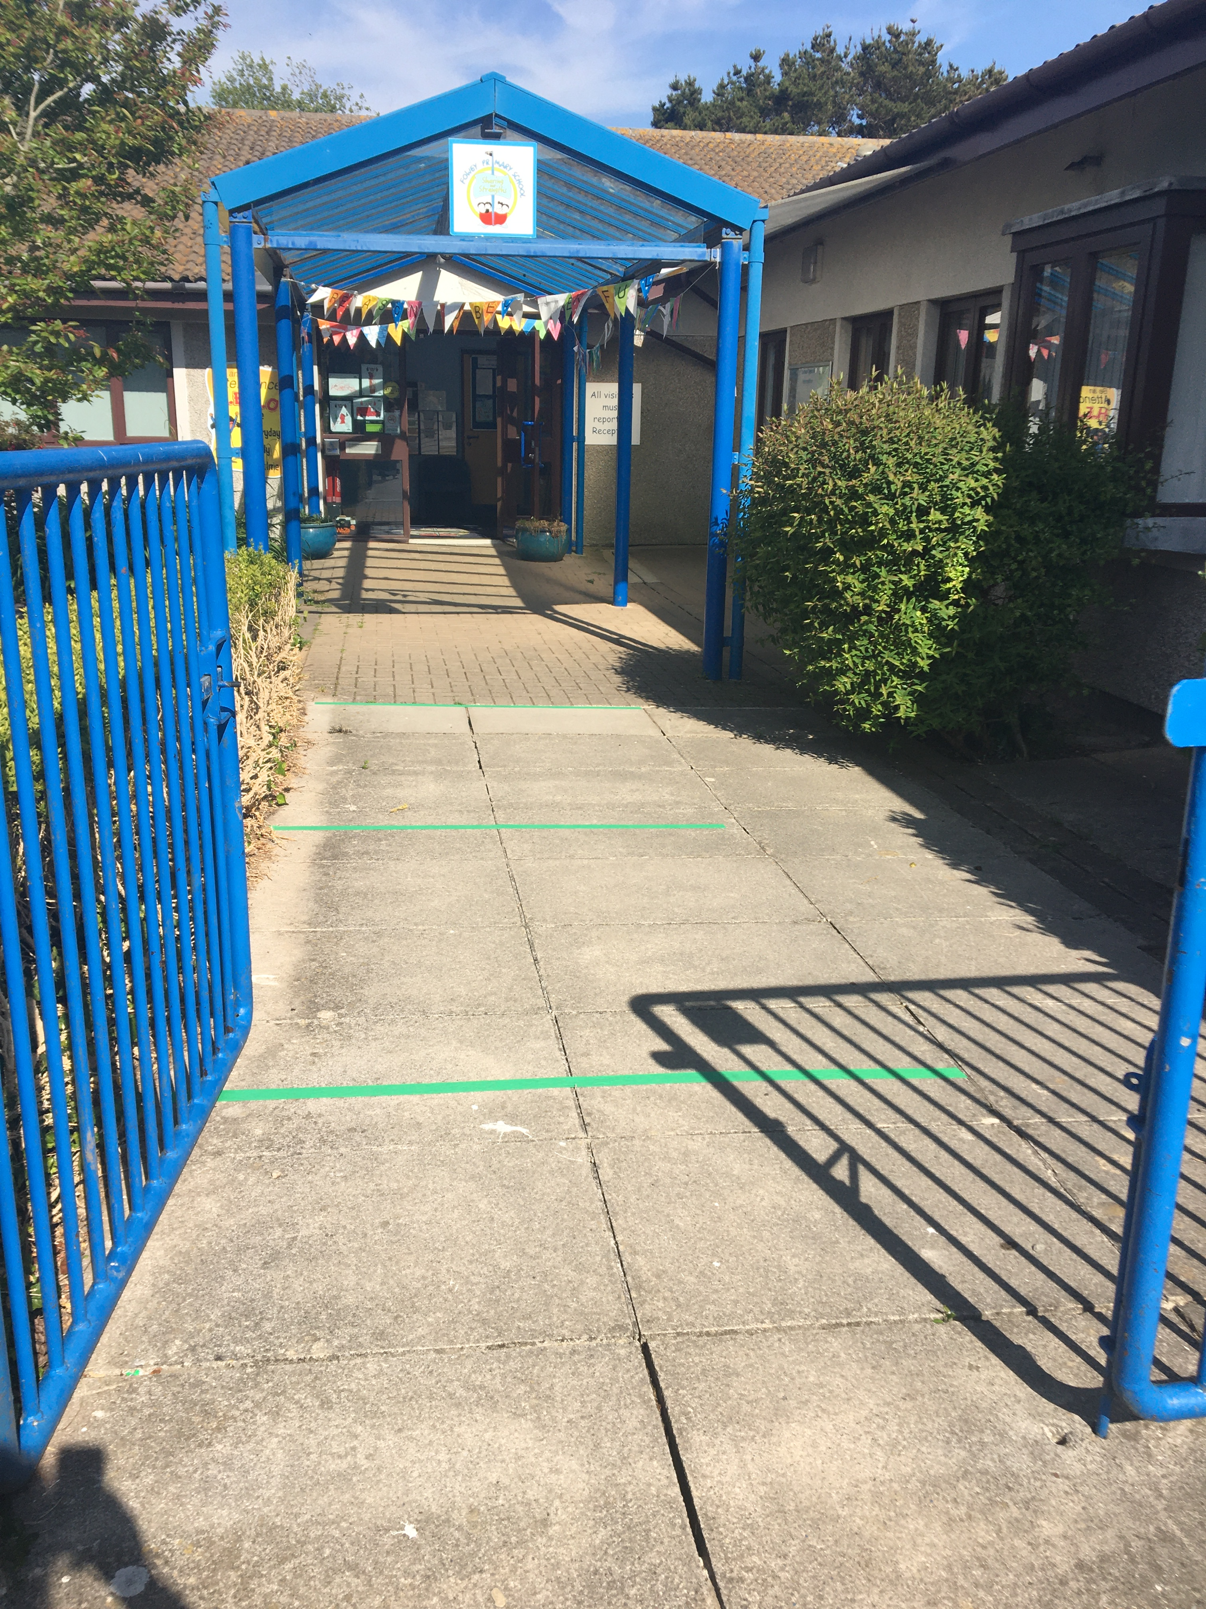
Pick up and Drop Off
We currently have two different pick up and drop off times to stagger the number of people.
One adult only per child- please do not bring siblings unless you have to
All adults near to wear a face mask.
Please don’t park in the school car park- parents use the car park at squires field
We cannot allow any dogs onto the school site or to be tied up in front of school

Slide 4
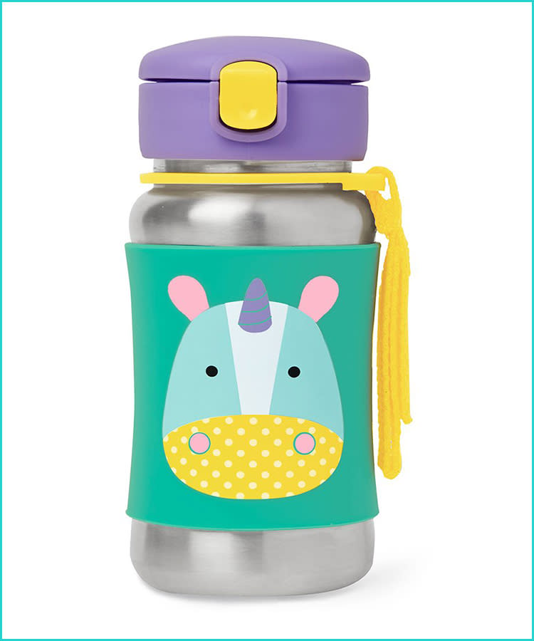
Food and Drinks
All classrooms have fresh water every day. Children need a reusable water bottle with a sealed lid.
It is safer if all children have school dinner. If you have to send packed lunch, please make sure your child can open everything themselves as staff won’t be able to help.
School lunches will be provided free as usual for all infants and all FSM eligible children.

Slide 5
In order to reduce the risk of infection we will:
Provide all children with an individual pouch of new stationary which they should use. Children should not share any equipment.
Clean all EYFS play equipment daily and provide enough for one each (e.g. bags of playdough).
At the moment we have to keep groups of children completely separate so they won’t mix at all during the school day.
Clean classrooms regularly throughout the day. We will involve children as monitors in this where we can.
Provide first aid within each group.
Have lidded bins and tissue stations in all classrooms.

Slide 6
In order to reduce the risk of infection we will:
Use doorstops and keep windows open to promote a good air flow
Be outside whenever we can in all classes
Not gather for assemblies or whole school events
Wash our hands and use hand sanitiser very regularly throughout the day
Stagger pick up and drop off times, maintaining social distancing during these times.
Have a line order and a table space.

Slide 7
You can help us reduce infection by:
Try not to use additional childcare so that children are mixing.
Maintaining social distancing on pick up and drop off- leaving promptly.
Staying out of the building at all times.
Encouraging your child to wash their hands and use the hand sanitiser.
Not having lengthy conversations with staff on pick up or drop off. Please e-mail if you need to speak to staff. Please try to keep a 2m+ distance from all staff at all times.
Keeping your child at home if they or anyone else at home has symptoms. You should apply for a test as quickly as you can.

Slide 8
What happens if a child shows symptoms:
If your child has a cough, temperature above 38.3 or experiences a change in taste/smell please do not send them into school. Please let us know you are keeping your child at home with symptoms and when they started.
You need to get a PCR test for your child and they can return as soon as you have a negative result.
If they test positive you must let us know straight away.
If your child shows symptoms at school they will be taken to the music room with any siblings. A member of staff will stay with them but they have to wear full PPE. We will phone you to collect your children straight away. You need to go straight home and isolate until you have a negative PCR result.

Slide 9
Positive Cases
If we’re informed of a positive case we will have to ask groups of children to isolate.
This could also happen if so many staff have to isolate that we can’t safely provide staff at school.
We try to communicate this as early as we can but, due to the nature of track and trace, this can sometimes be very short notice.
It’s very important that we have your correct e-mail addresses and phone numbers. The office will give you instructions to download the E-Schools App which is the best way to keep up with everything that’s going on.

Slide 10
Children with symptoms
We have a number of very vulnerable children at Fowey Primary and in our wider community.
Because of this risk we work really closely with our parents to take a cautious approach. If you feel your child might have symptoms or could have been in contact with a positive case please contact us before coming into school.

Slide 11
Questions?

Slide 12
What happens next…
Keep coming along to our learning together sessions, which should be back next week!
Complete the induction form on the website
Check the activities Mrs Jones has posted online
Join the school Facebook page
We’ll get back to you with arrangements for September as soon as we know

